Slide 1
Who works at CI and How does that compare to the CSU system?
Sources of Data:
https://csyou.calstate.edu/Divisions-Orgs/bus-fin/budget/Pages/final-budget-and-actual-summaries.aspx https://www.csuci.edu/apb/factbook18-19/tenure-density-chart.pdf https://www.csuci.edu/apb/factbook18-19/faculty-trends-2011-2021.pdf https://www.calstate.edu/csu-system/about-the-csu/facts-about-the-csu/Documents/facts2021.pdf https://www.calstate.edu/data-center/institutional-research-analyses/files/Fall/CSU%20Enrollment%20Summary/2010-2021/CSU%20Enrollment%20Summary%20(2010-2021).xlsx https://www.calstate.edu/impact-of-the-csu/government/Advocacy-and-State-Relations/legislativereports1/California-State-University-Tenure-Track-Faculty-Hiring.pdf

Slide 2
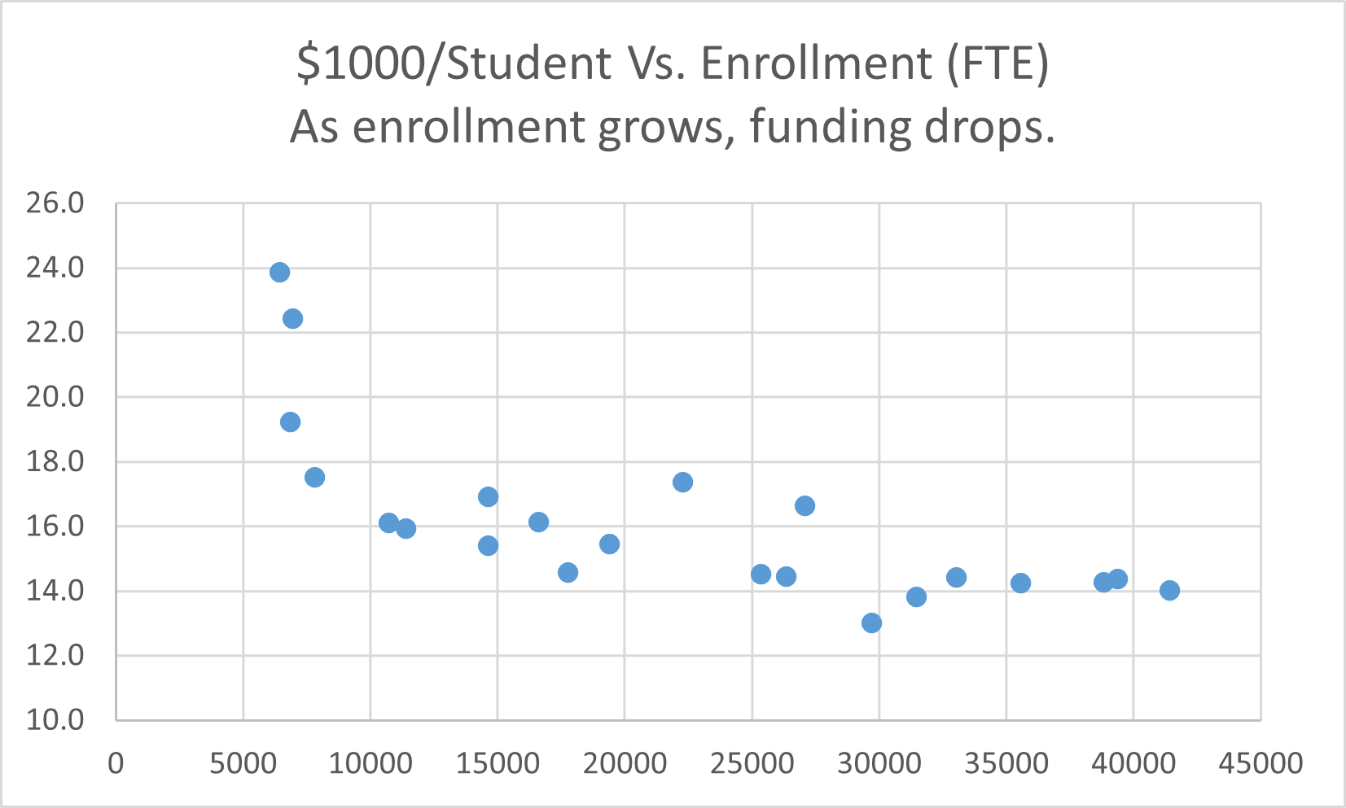
CSUCI Had ~$22,000 per student in funding.
$1000 per student
CSU Maritime excluded: over $46,000 on the y-axis.
Enrollment (Full Time Equivalent Students (FTES))
$15,200 is average funding per student systemwide. CI is ~ 45% above the average!

Slide 3
CI has more employees per student than the CSU system.
Small Six Campuses: Bakersfield, East Bay, Humboldt, Monterrey Bay, Sonoma, Stanislaus
Large Six Campuses: Fullerton, Long Beach, Northridge, Sacramento, San Diego, San Jose
CI has over 40% more employees per student than the system average.
Next question is: what type of employee? How does CI compare?

Slide 4
CI employs more MPP per student than other small campuses, but fewer tenure track faculty per student.
CI has 96% more MPP per student than
system average.
CI has 3.5% more tenure track faculty
per student than the system average.
Small Six Campuses: Bakersfield, East Bay, Humboldt, Monterrey Bay, Sonoma, Stanislaus
Large Six Campuses: Fullerton, Long Beach, Northridge, Sacramento, San Diego, San Jose

Slide 5
What has CI Done with $22,000 per student?
Next, let’s look, in detail, at who is employed at CI versus the CSU.
Small Six Campuses: Bakersfield, East Bay, Humboldt, Monterrey Bay, Sonoma, Stanislaus
Large Six Campuses: Fullerton, Long Beach, Northridge, Sacramento, San Diego, San Jose

Slide 6
Who does CI Employ?
Fall 2020 Employee data provided by BFA thanks to Lisa Woods
26.5% Tenure Track Faculty
9.0% MPP
42.4% Staff
22.2% Lecturers*
19.4% Tenure Track Faculty
12.4% MPP
45.6% Staff
22.6% Lecturers
Each 1% at CI is about 8 people (full time equivalent).
Lecturer % is about identical
* CI lost a lot of lecturers since Fall 2020.

Slide 7
How does CI stack up to other small campuses? Small CSU: Bakersfield, East Bay, Humboldt, Monterrey Bay, Sonoma, Stanislaus
25.0% TT
10.0% MPP
46.8% Staff
18.3% Lecturers
19.4% Tenure Track Faculty
12.4% MPP
45.6% Staff
22.6% Lecturers

Slide 8
2020 was the highest tenure density at CI

Slide 9
2021 Budget Does Not Call for Instructional Cuts.
CAMPUS BUDGET PLAN for FY 22-23 (sharepoint.com)
So why are chairs being asked to cut 20% to 45% of all course sections?

Slide 10
Thank you for your attention!
Much, much more info
Various slides follow to address specific concerns
I’ve been doing this for more than 10 years now
The resolution is a very small step to take in light of this data.
From the GI 2025 website at calstate.edu:
2017-18 Support Budget: Graduation Initiative 2025 | CSU (calstate.edu)
Below are the five priority areas for Graduation Initiative 2025:
Tenure-Track Faculty Hiring: Campuses will continue to prioritize the hiring of tenure-track faculty and to improve the ratio of tenure and tenure-track faculty to lecturers, as well as improve student/faculty ratios. ...
Improved Course Taking Opportunities: ...
Enhanced Advising and Education Plans: ...
Academic and Student Support: ...
Actively Leveraging Data: ...

Slide 11
Trends in CSU Hiring: 2016-2021
From CSU Employee Profiles
1095 new Full Time Employees
792 are faculty
438 are tenure track
72% of all new employees are faculty
Fall2016CSUProfiles.pdf (calstate.edu)
The Employees Of The California State University (calstate.edu)

Slide 12
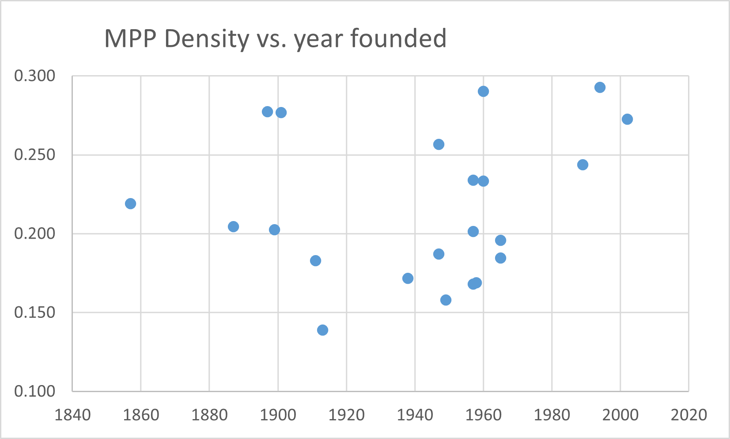
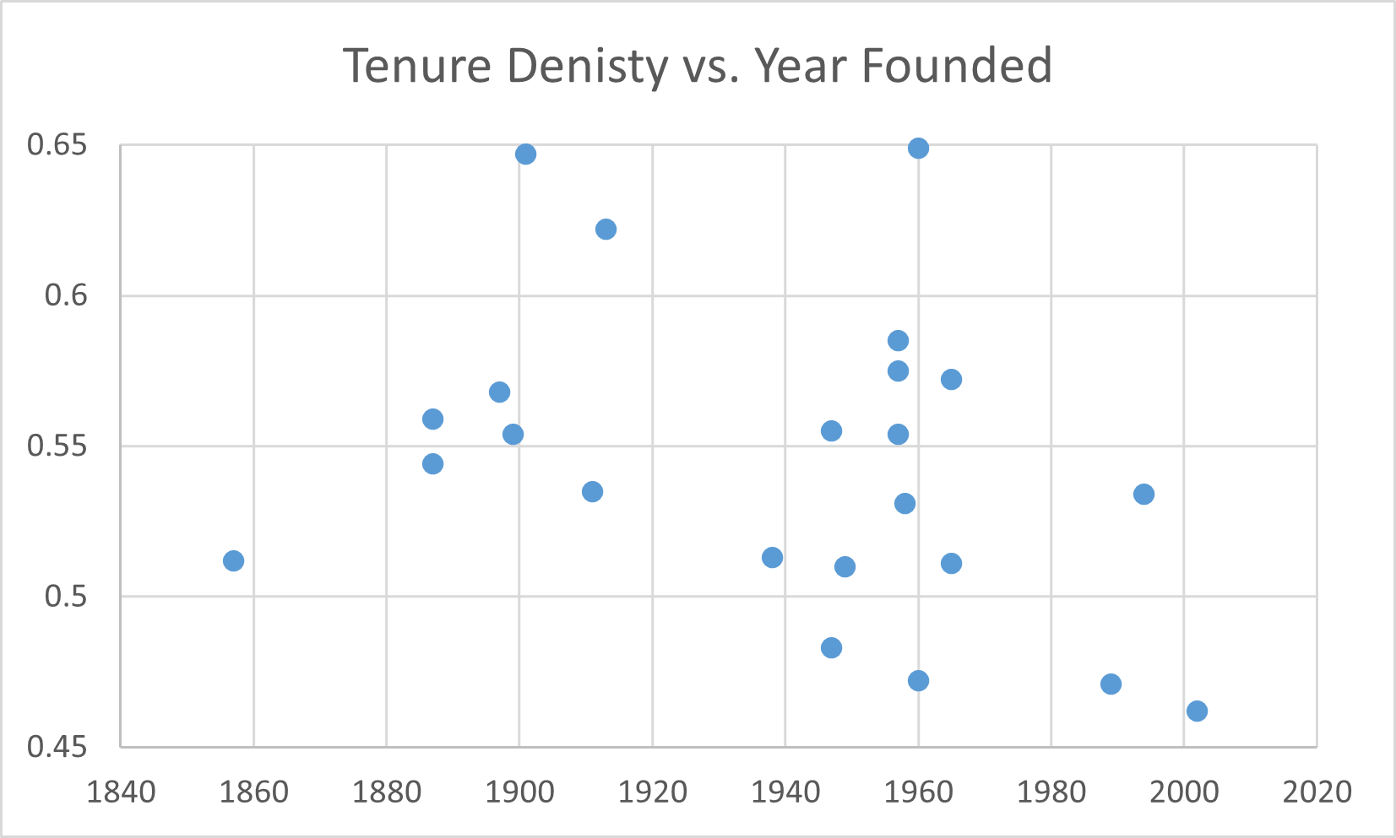
Does tenure density improve with campus age?

Slide 13
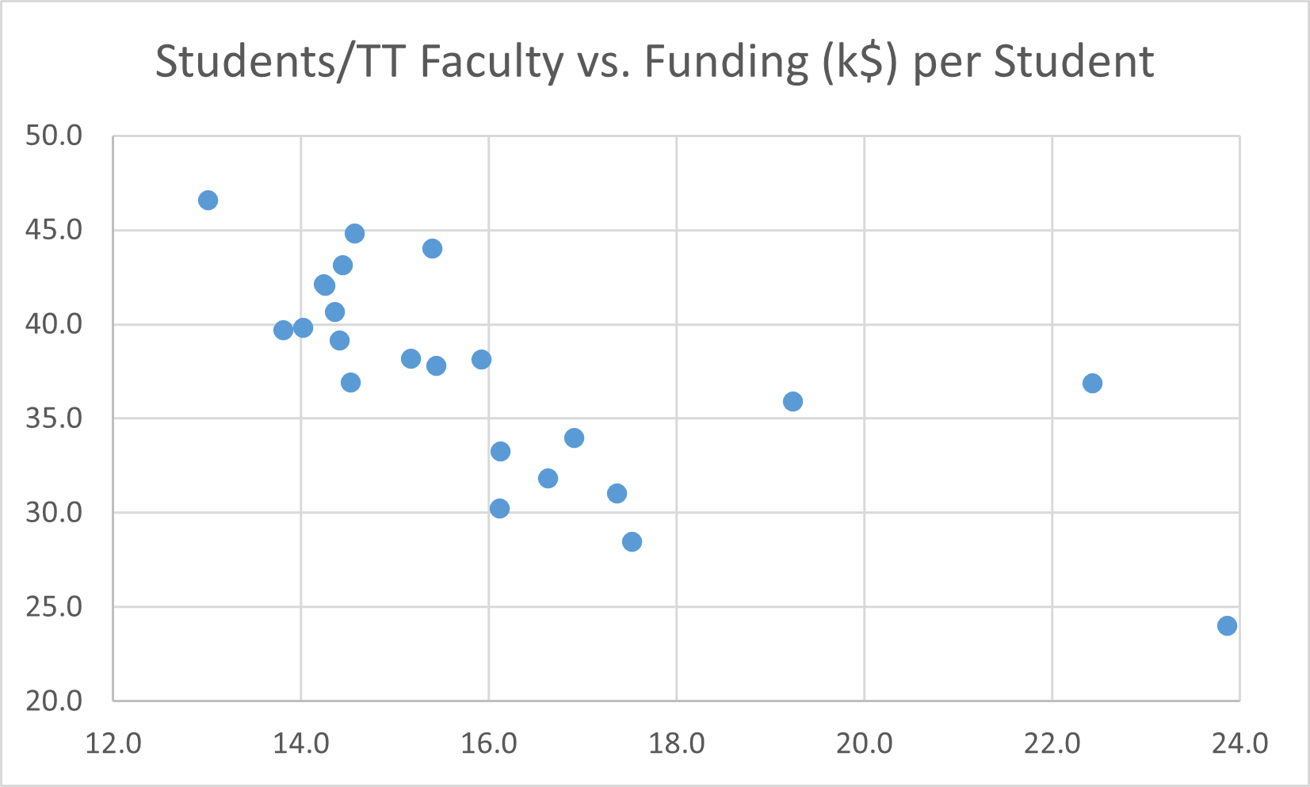
Does CI have sufficient funding?
Maritime is not presented as the campus is off the charts (47.3 on x-axis).

Slide 14
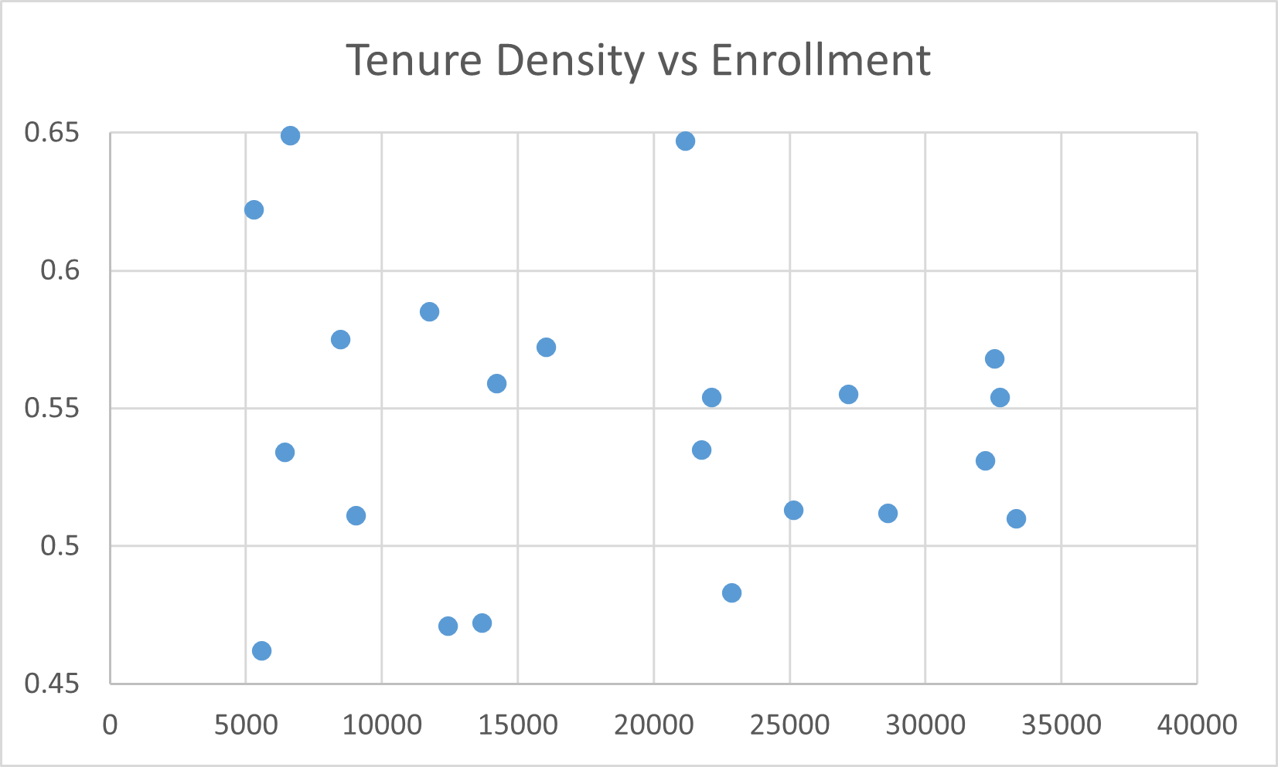
Do all small campuses have low tenure density?
The low tenure density at CI is a choice every year.

Slide 15
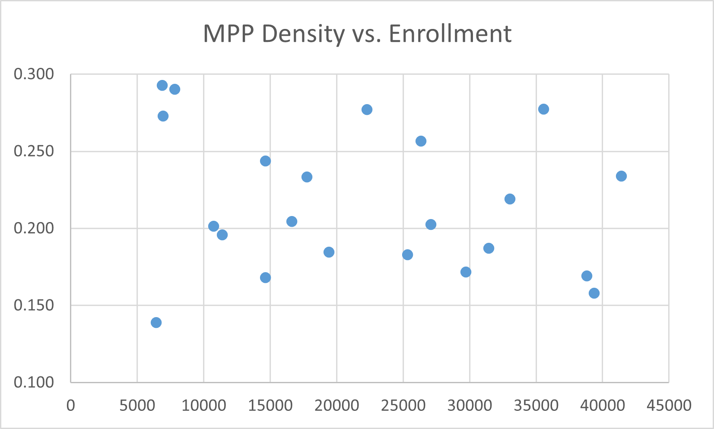
OK what about MPP density vs. size?

Slide 16
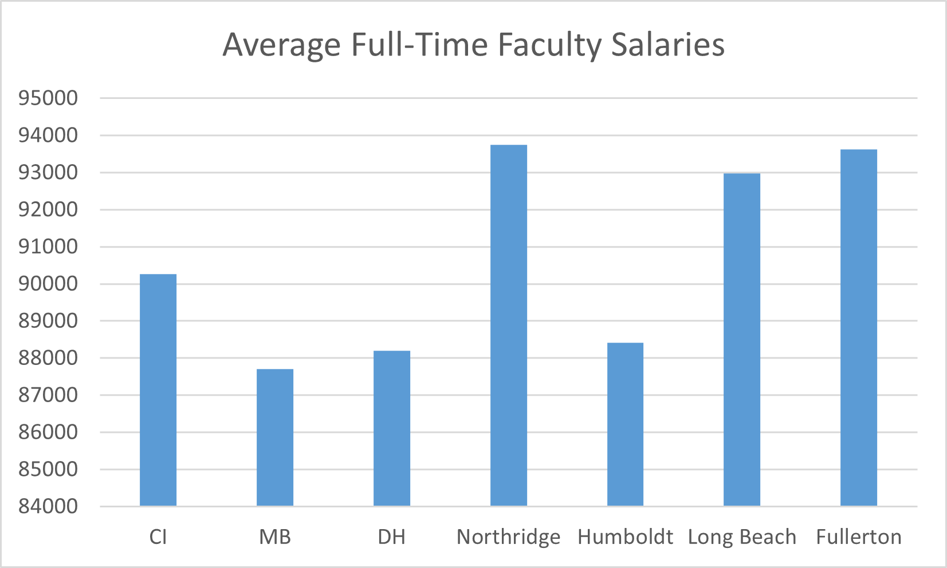
CI Faculty Salaries Are Low.
Source: ipeds data center: https://nces.ed.gov/ipeds/datacenter San Marcos does not report salary info.
Maritime $91332

Slide 17
Hiring decisions should be data-based
I have been asking for this information, repeatedly
I am happy to provide all files
Ideally, this is the start of a data-informed conversation
Please take enrollment seriously
Funding charting our course would be a useful first step

