Slide 1
The Schedule Template
Task Force & Policy
Schedule Template Task Force AY23-24

Slide 2
Agenda
01.
What is the Schedule Template?
02.
Who is on the Schedule Template Task Force?
03.
The Schedule Template Policy
04.
Old vs New Template Comparison
05.
Questions
Schedule Template Task Force AY23-24

Slide 3
What is the Schedule Template?
The Schedule Template is the list of official or standardized start and end times for classes scheduled in each term’s Schedule of Classes.
The standardized start and end times are referred to as ‘time blocks’ (or just blocks).
The length of the blocks depends on the number of hours of instruction or in-class time needed to meet the requirements for the class’ units.
The official time blocks are set by policy, meaning any changes require a new policy or updates to existing policy.
Schedule Template Task Force AY23-24

Slide 4
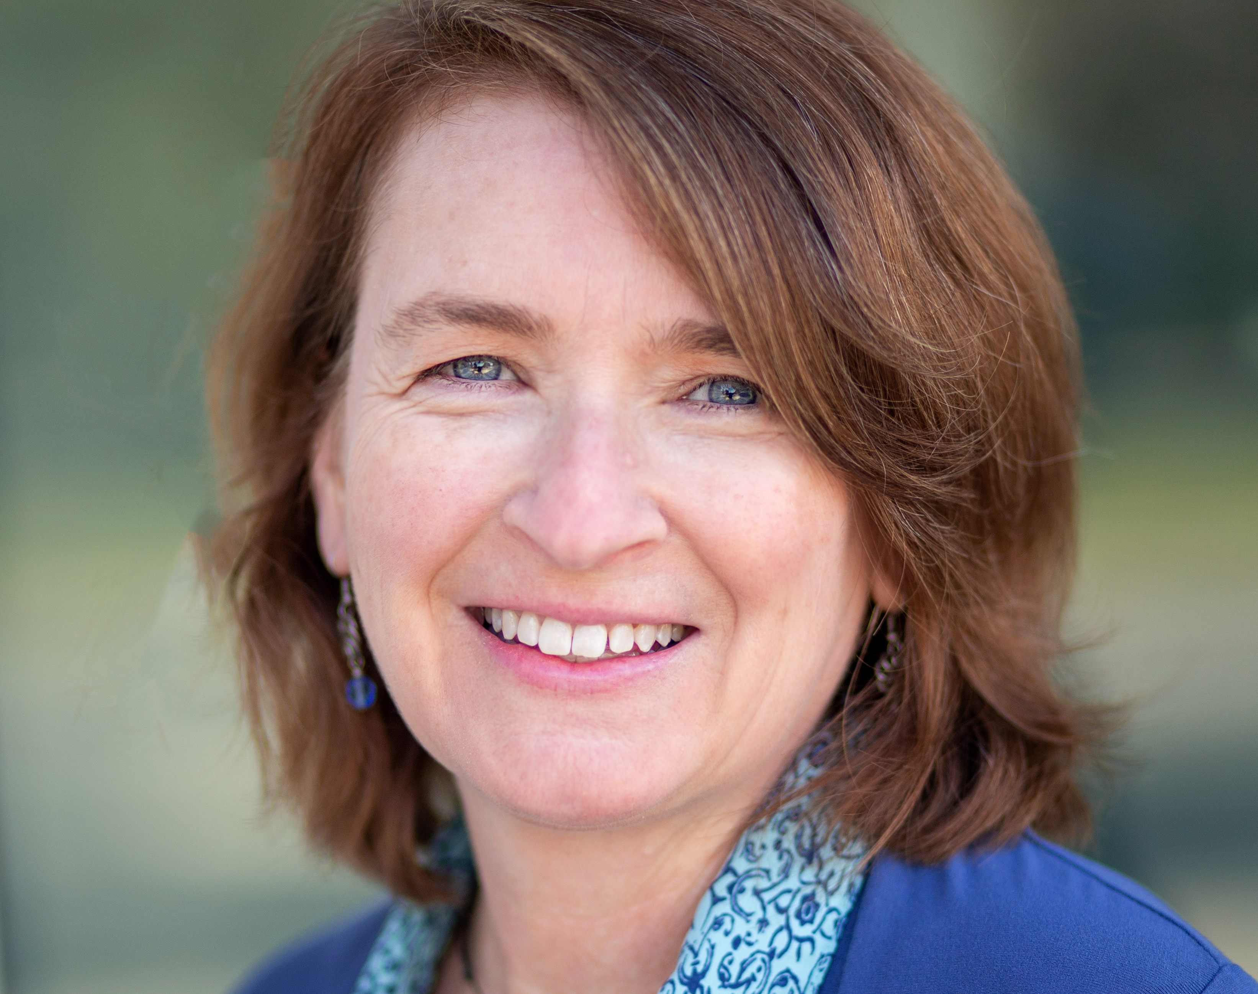
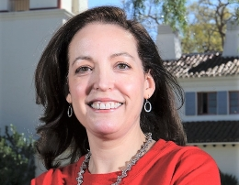
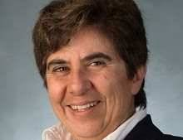
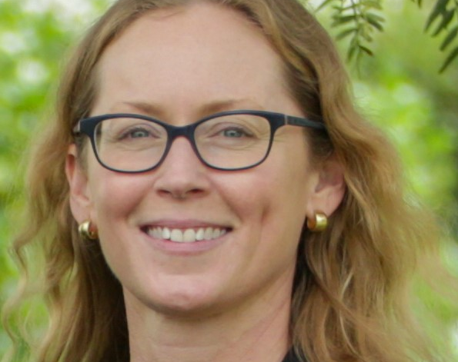
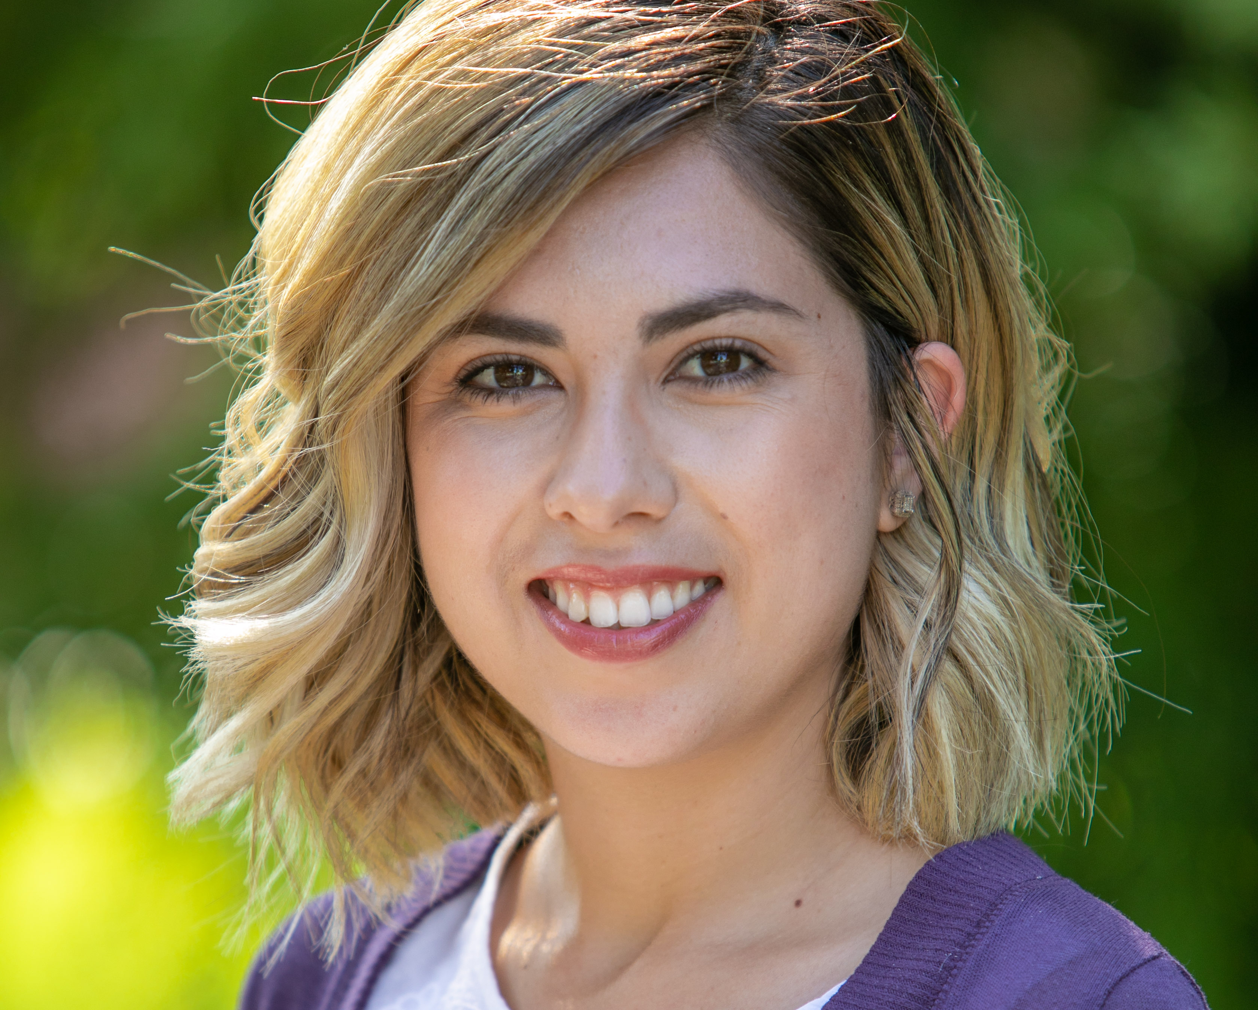
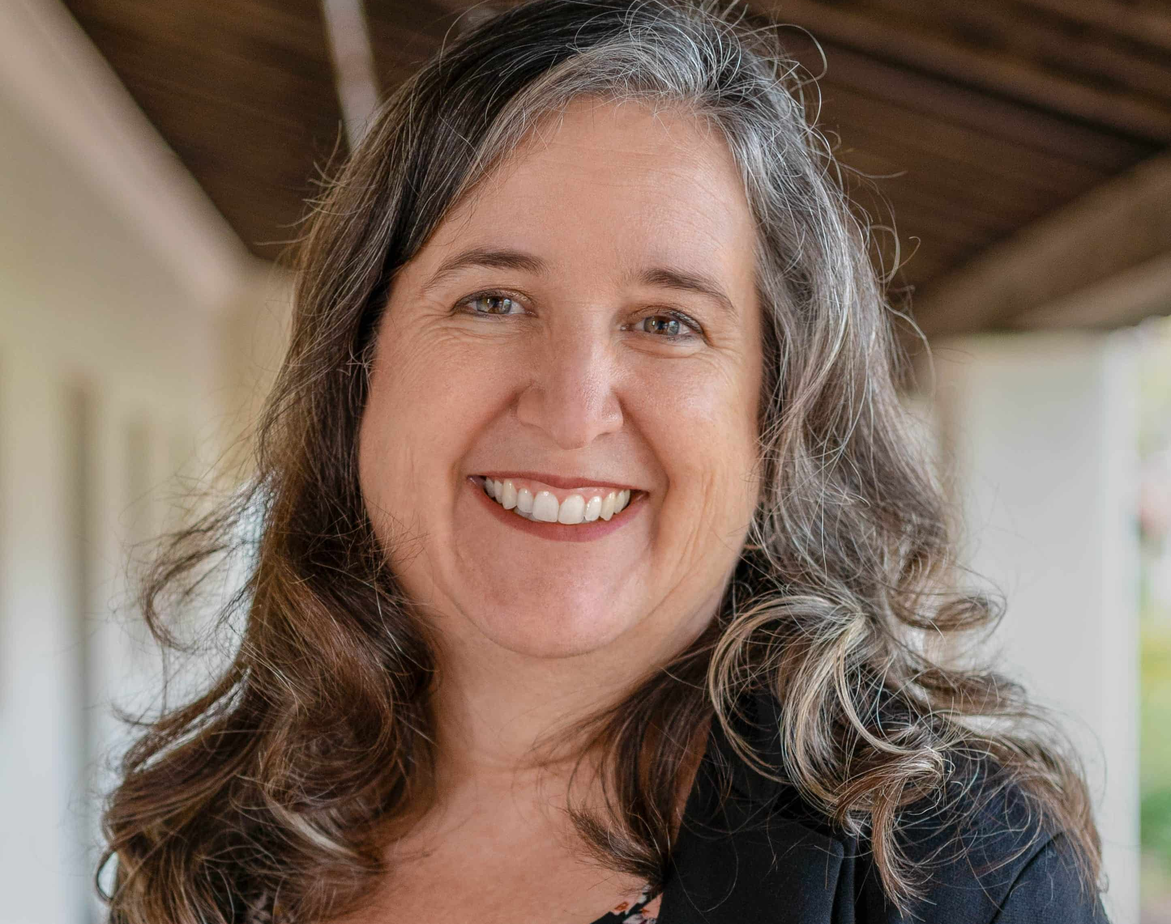
Who is on the
Schedule Template Task Force?
Stacey Anderson
Lorna Profant
Sonsoles de Lacalle
Lina Neto
Chair of English
Professor of Biology
Chair of Health Science
AVP for Academic Programs
Colleen Forest
Rebecca Slocum
Andrea Cruz
Mary Laurence
University Registrar
Schedule of Classes Coordinator
Academic Advisor
Manager of Academic Space Planning
Schedule Template Task Force AY23-24

Slide 5
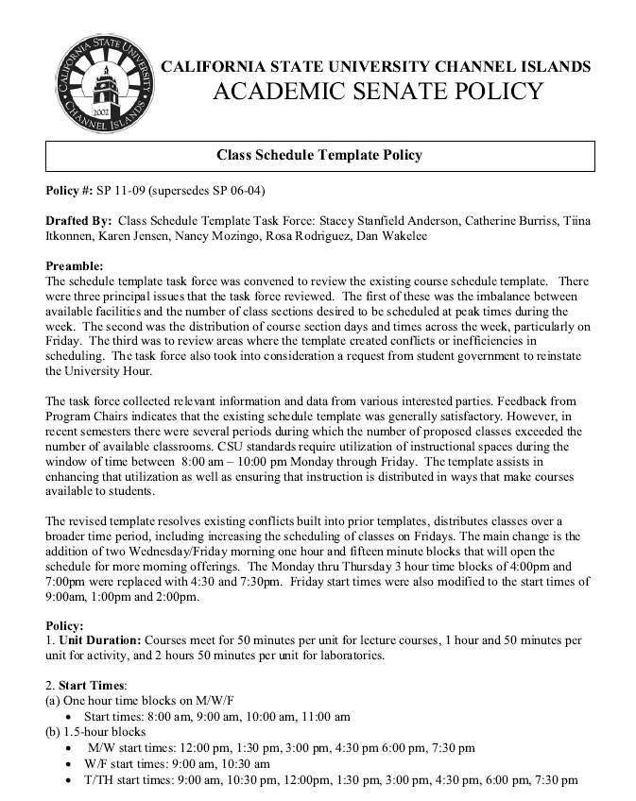
Schedule Template Policy
The Schedule Template Policy includes:
The standardized time blocks
The official day/time of University Hour
Exceptions to the requirement to use standardized time blocks (primarily studio/lab classes)
Procedures for scheduling ‘off-template’
Official standards for class breaks
Current Official Policy is Senate Policy (SP) 11-09
Link to SP 11-09
Schedule Template Task Force AY23-24

Slide 6
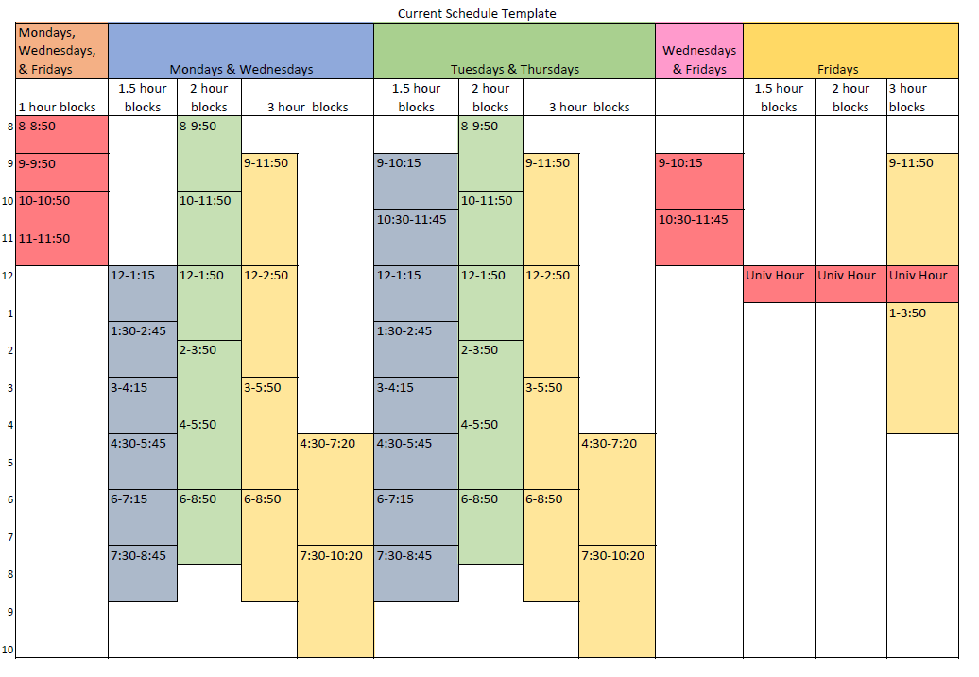
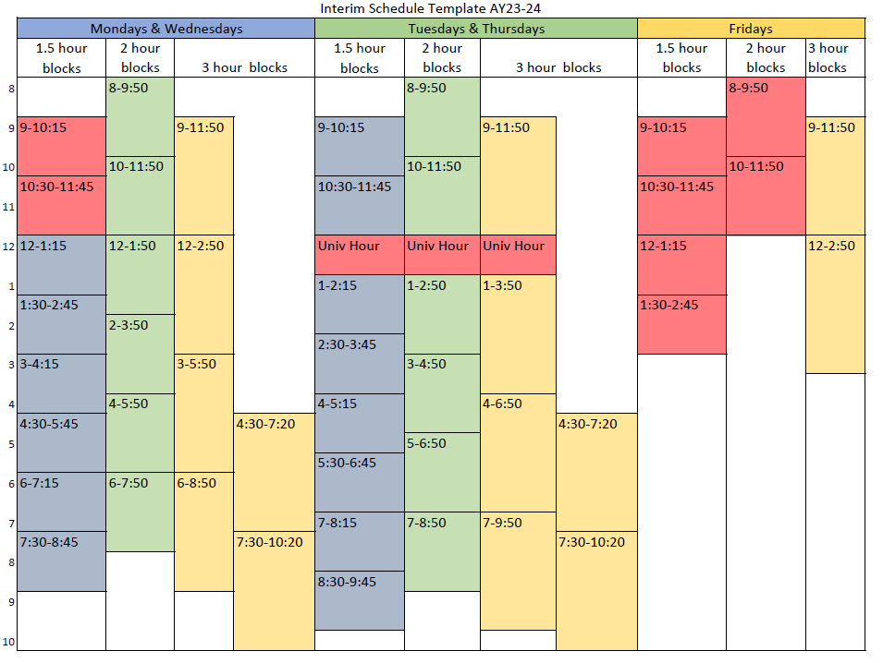
Old vs New Template Comparison
Small changes (below) were rolled out on an interim basis for for Academic Year 2023-2024
ADD A MAIN POINT
Schedule Template Task Force AY23-24

Slide 7
Questions?

Slide 8
Thank you!
Presentors
Chair of English: Stacey Anderson
University Registrar: Colleen Forest
Schedule of Classes Coordinator: Rebecca Slocum
Manager of Academic Space Planning: Mary Laurence
Schedule Template Task Force AY23-24

